Slide 1

To predict the selling price of used cars by using various ML algorithms and comparing them.
Presented By:
Shubham kumar
04751202819
Guided By:
Assistant Professor Racha Jain

Slide 2
Motivation
Finding the appropriate price for second hand car is a hectic task.
When you ask experts before buying a second hand car it costs extra charges.
But what if you can find the correct price as desired by you by just sitting at home, by entering details of the car.

Slide 3
Introduction
Objectives
1.Implement various models which could give you estimated price, one should pay given the choice of features by the user.
2.Comparing and finding out which algorithm works best for finding selling price.

Slide 4
Methodology
Analyzing and preprocessing of the data.
Finding correlation between features.
Deploying various models and comparison
Scores and statistics of best model.
Collecting Data

Slide 5
Our Approach
Collecting the data and pre-processing of the features.
We trained our model using different techniques:
Linear Regression
Lasso Regression
Ridge Regression
Support Vector Regressor(SVR)
Random Forest
We applied various algorithms and by plotting the graph for errors, found out the best algorithm for the task.

Slide 6
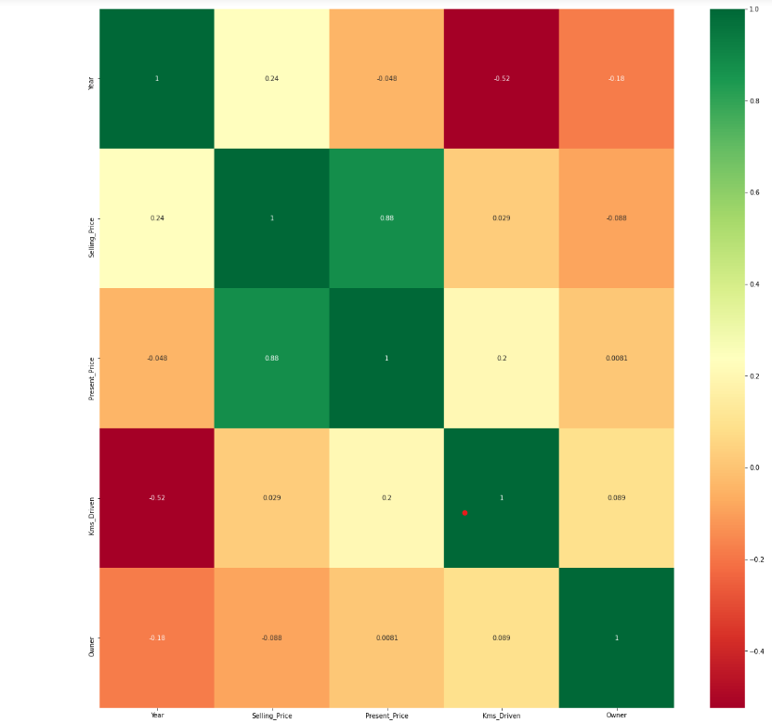
Heatmap of the features depicting their correlation.

Slide 7
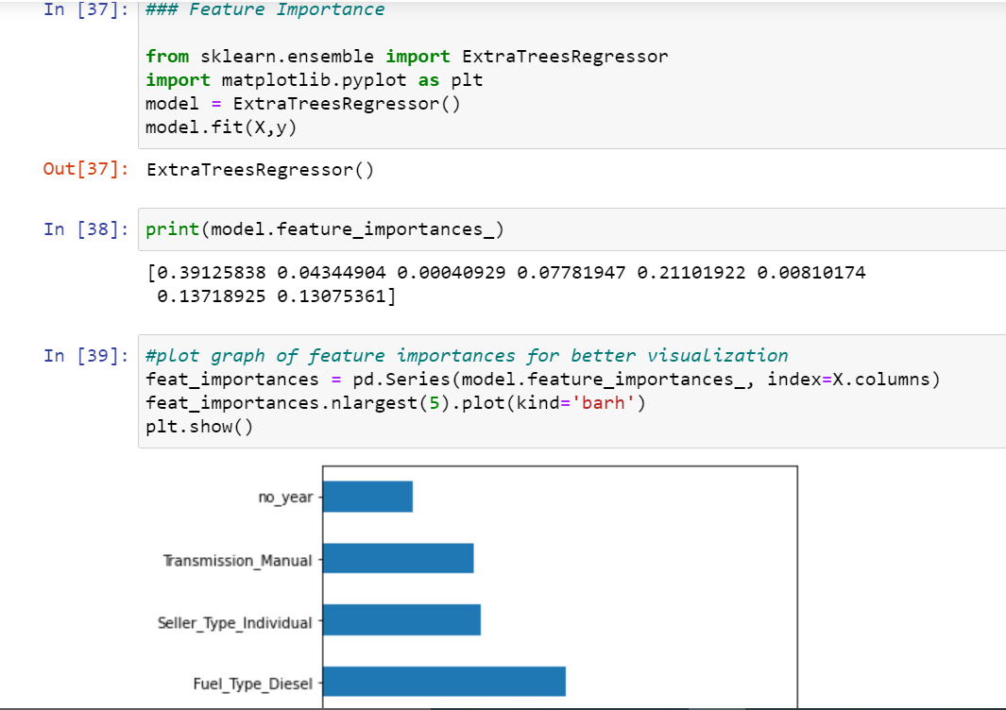
Graph depicting feature importance

Slide 8
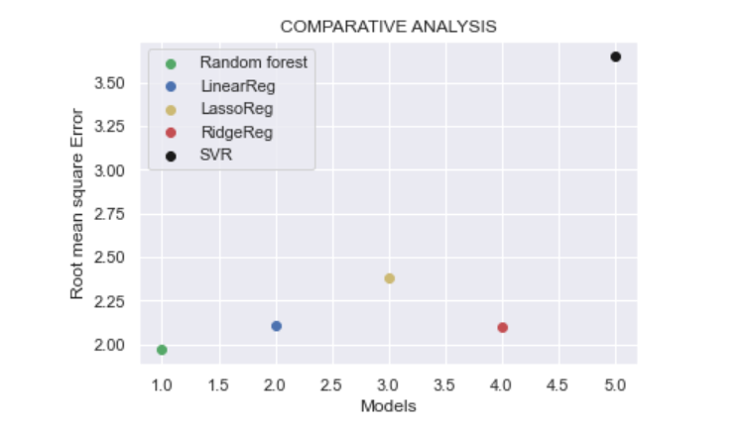
Results
Comparative analysis of various algorithms

Slide 9
Accuracy and error of various model used
Algorithm | MAE | RMSE | Accuracy
Random forest | 0.87 | 1.98 | -4.025
Linear regression | 1.24 | 2.10 | 85.17%
Lasso regression | 1.44 | 2.37 | 81.11%
Ridge regression | 1.23 | 2.10 | 85.20%
SVR | 1.67 | 3.65 | 55.35%

Slide 10
Conclusion
Best results were given by Random Forest .
This is because :
Decision Trees itself are a low bias high variance model but when decision trees combine to form a random forest their accuracy increases on testing data as well.
That’s why a random forest has both low bias and low variance and thus yielding better output.

Slide 11
Future work
We can enlarge the datasets by combining it with the data from various online platforms like OLX, so that we can get more accurate predictions.
Making the front-end for the python file so as to create a website where a customer can enter the important details and find out the accurate selling price of the car for entered details.
Doing more hyper parameter tuning (learning rate, batch size, number of layers, number of units, dropout rate, batch normalization etc.). We can implement this on SVR and find out if the accuracy improves ( i.e. use RandomisedSearchCV, GridSearchCV).

Slide 12
References
[1]https://www.geeksforgeeks.org/plotting-histogram-in-python-using-matplotlib/
[2]https://scikit-learn.org/stable/modules/generated/sklearn.linear_model.Ridge.html
[3]https://www.kaggle.com/nehalbirla/vehicle-dataset-from-cardekho
[4]https://www.mygreatlearning.com/blog/understanding-of-lasso-regression/#:~:text=Lasso%20regression%20is%20a%20regularization,i.e.%20models%20with%20fewer%20parameters).
[5]https://towardsdatascience.com/ridge-regression-for-better-usage-2f19b3a202db
[6]https://www.youtube.com/watch?v=p_tpQSY1aTs&t=3428s
[7] M. Antonakakis, T. April, M. Bailey, M. Bernhard, E. Bursztein, J. Cochran, Z.Durumeric, J. A. Halderman, L. Invernizzi, M. Kallitsis, D. Kumar, C. Lever, Z. Ma, J. Mason, D. Menscher, C. Seaman, N. Sullivan, K. Thomas, and Y. Zhou,"Understanding the Mirai botnet," in Proc. of USENIX Security Symposium, 2017.

Slide 13
Thank you.

